Slide 1

Data Wrangling

Slide 2
Objectives
Describe data normalization
Demonstrate the use of binning
Demonstrate the use of categotical variables
Data Wrangling

Slide 3
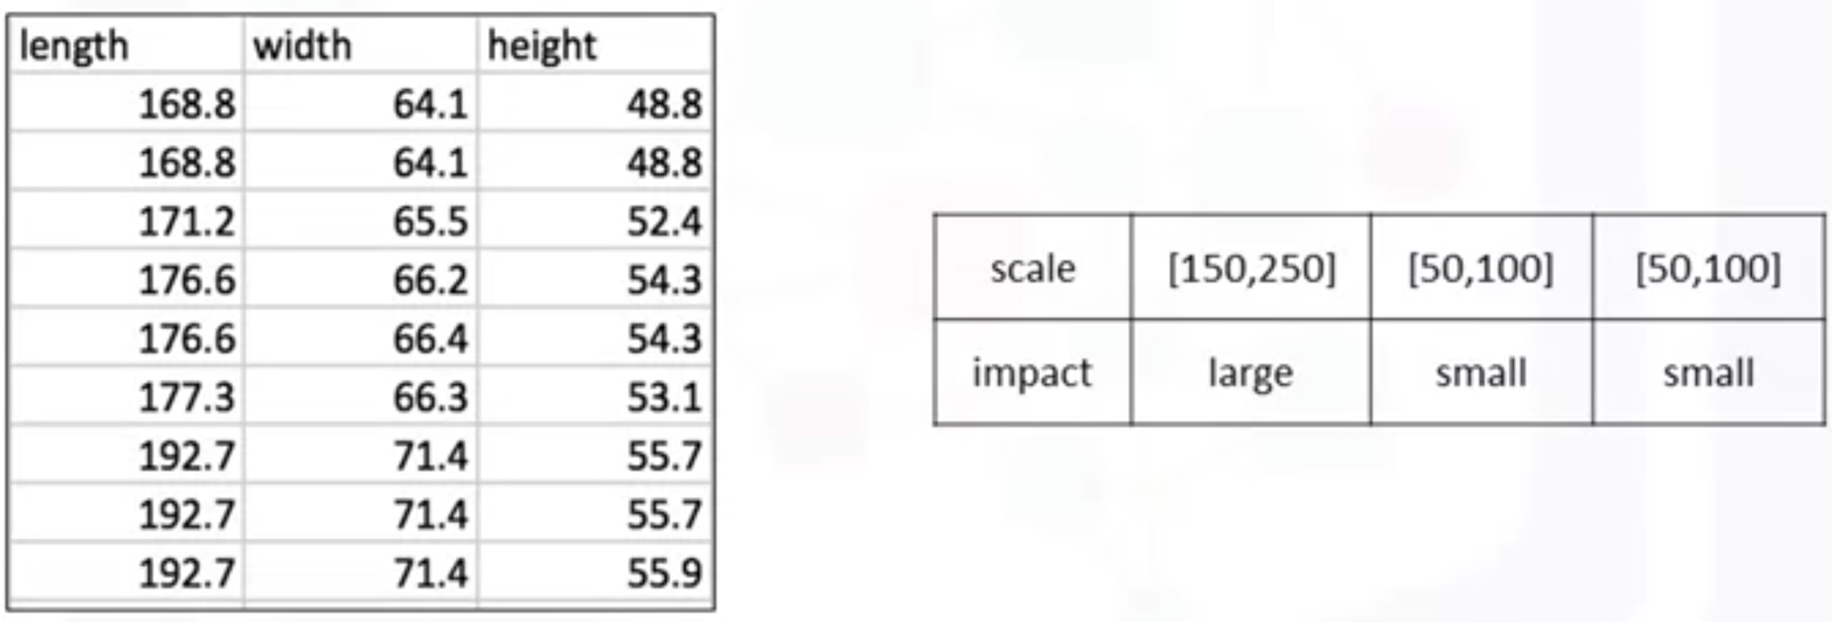
Data Normalization in Python
Uniform the features value with different range.
The used car data set:
  The feature length ranges from 150-250,
  The feature width and height ranges from 50-100.
We may want to normalize these variables so that the range of the values is consistent.
This normalization can make some statistical analyses easier down the road.
Data Wrangling

Slide 4
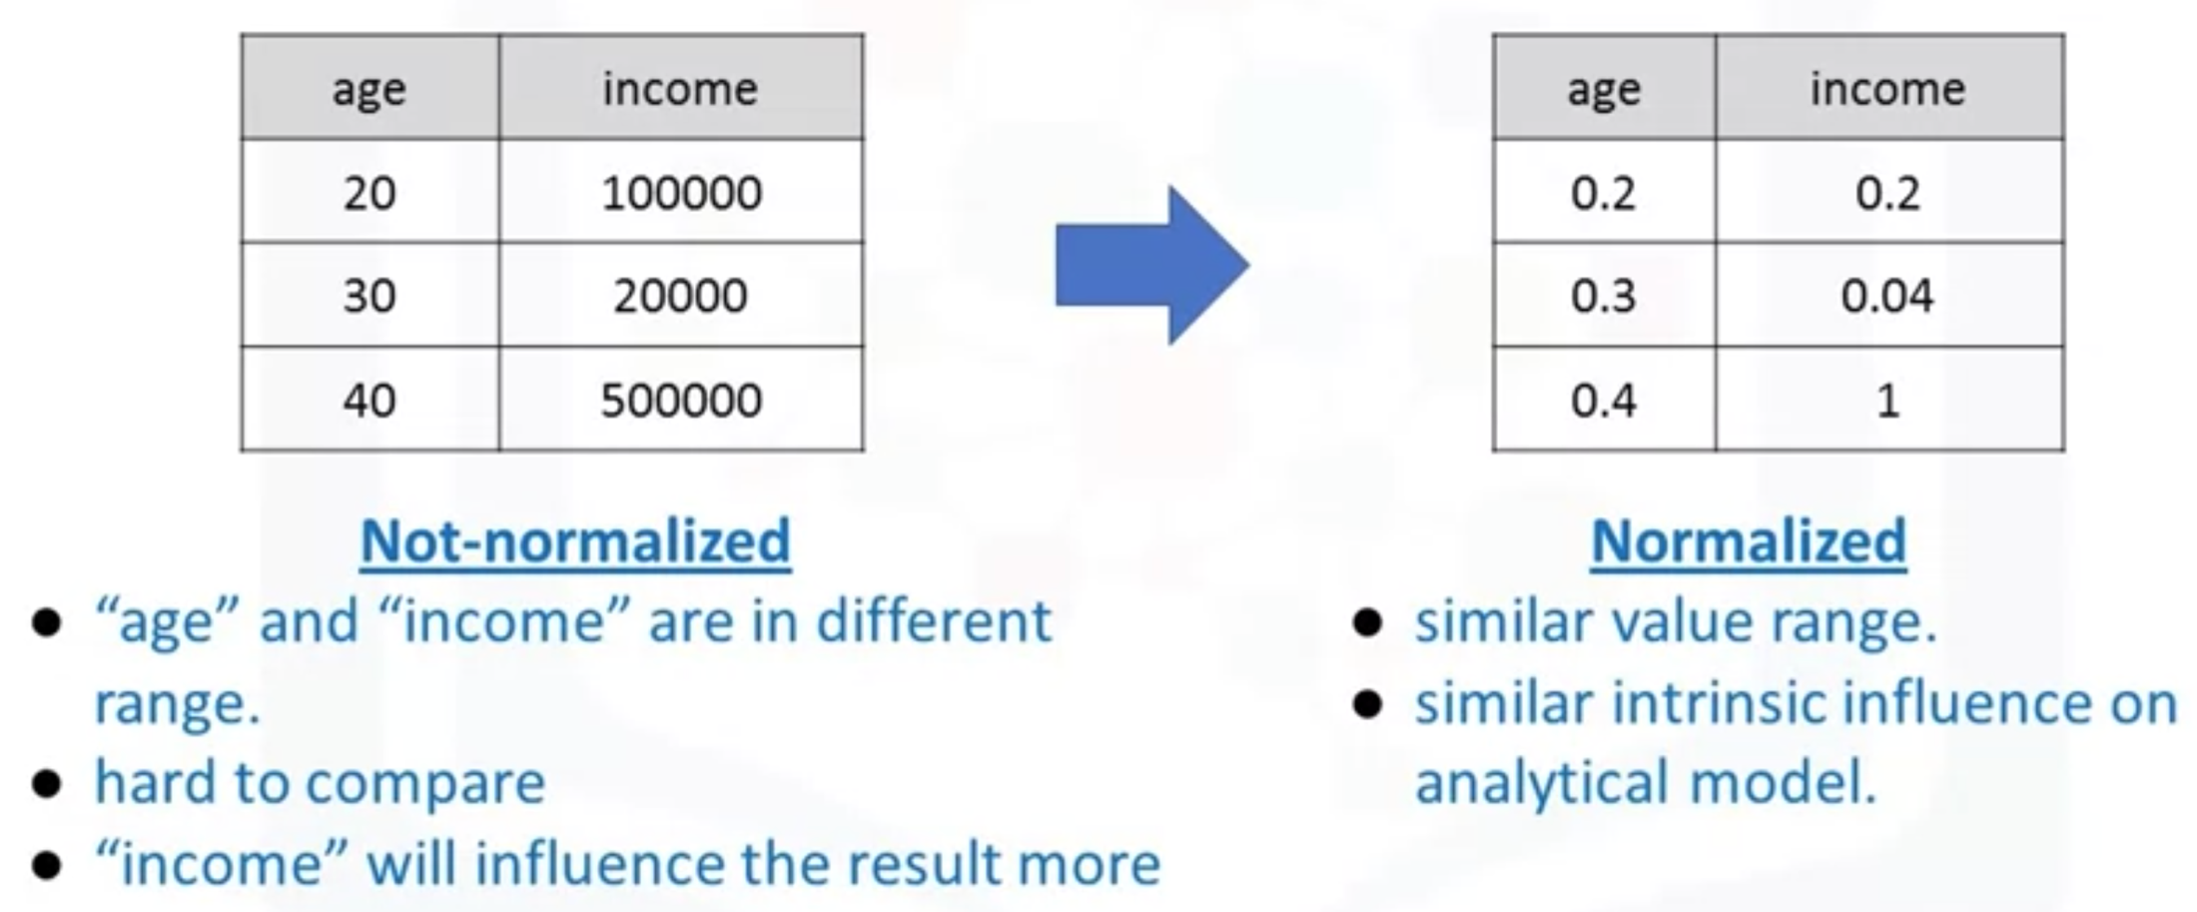
Data Normalization in Python
Why data normalization is important?
Student give the answers ?
Data Wrangling

Slide 5
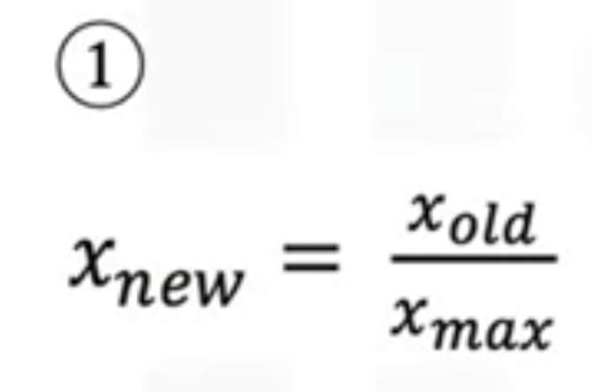
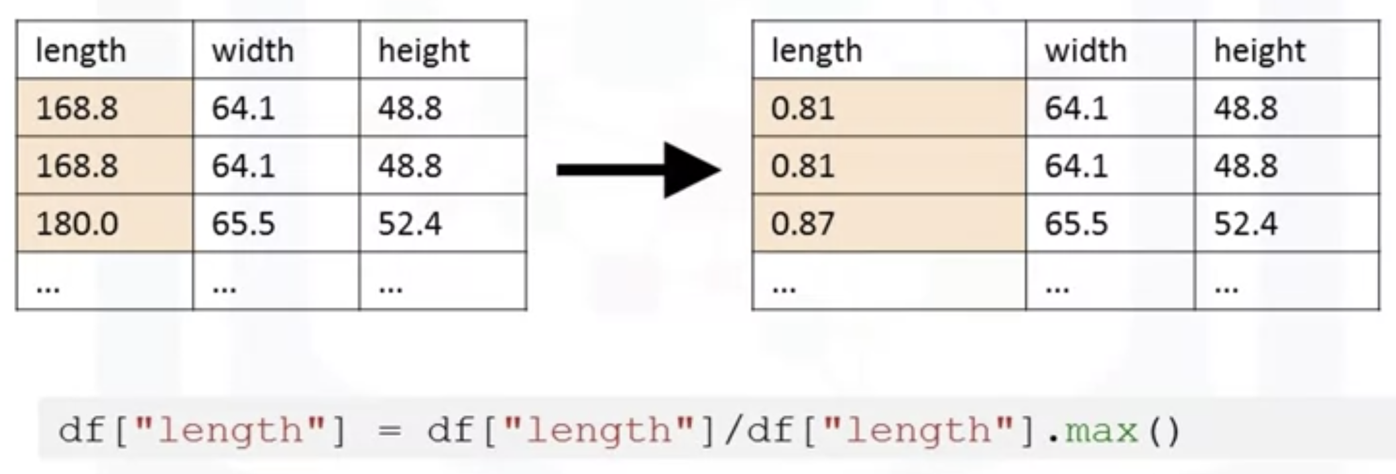
Data Normalization in Python
Methods of normalizing data
  Simple feature scaling: divides each value by the maximum value for that feature.➔ The new values range between zero and one.
Data Wrangling

Slide 6
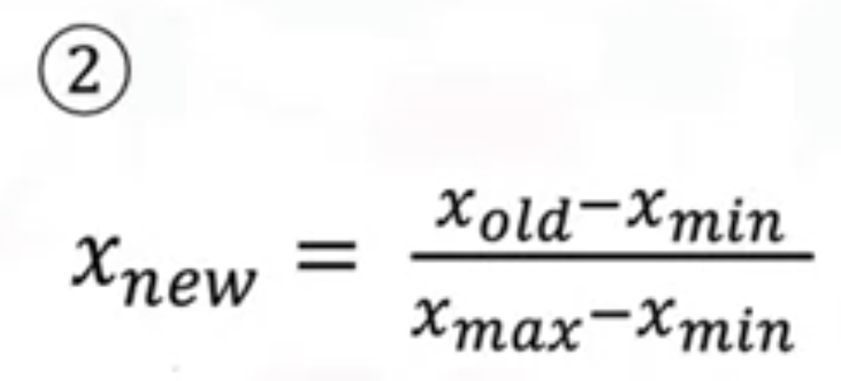
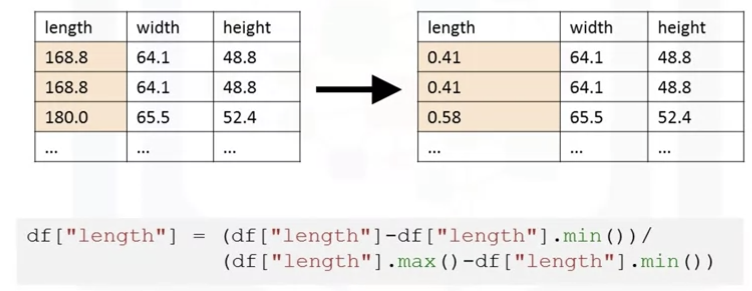
Data Normalization in Python
Methods of normalizing data
  Min-max: each value X_old subtract it from the minimum value of that feature, then divides by the range of that feature.→ new values range between zero and one.
Data Wrangling

Slide 7
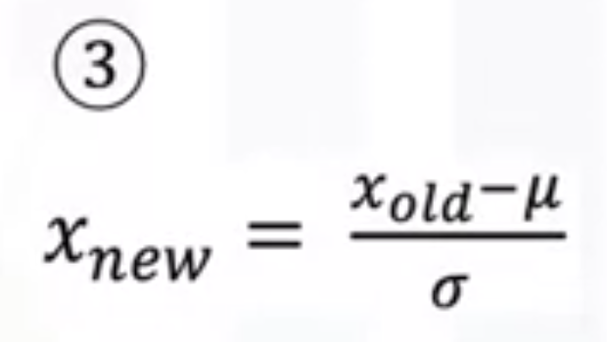
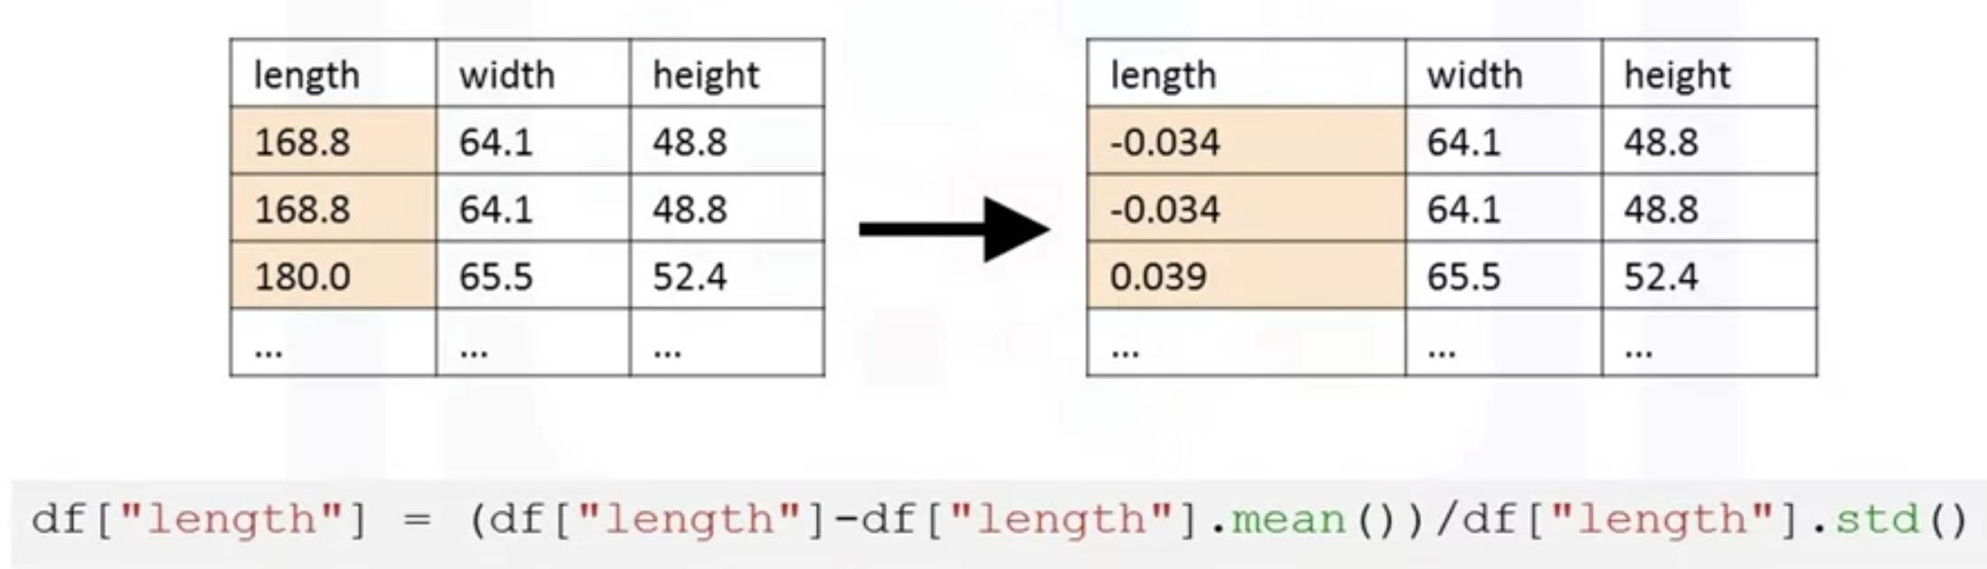
Data Normalization in Python
Methods of normalizing data
  Z-score: each value you subtract the mu and then divide by the standard deviation sigma.➔ The resulting values hover around zero.
Data Wrangling

Slide 8
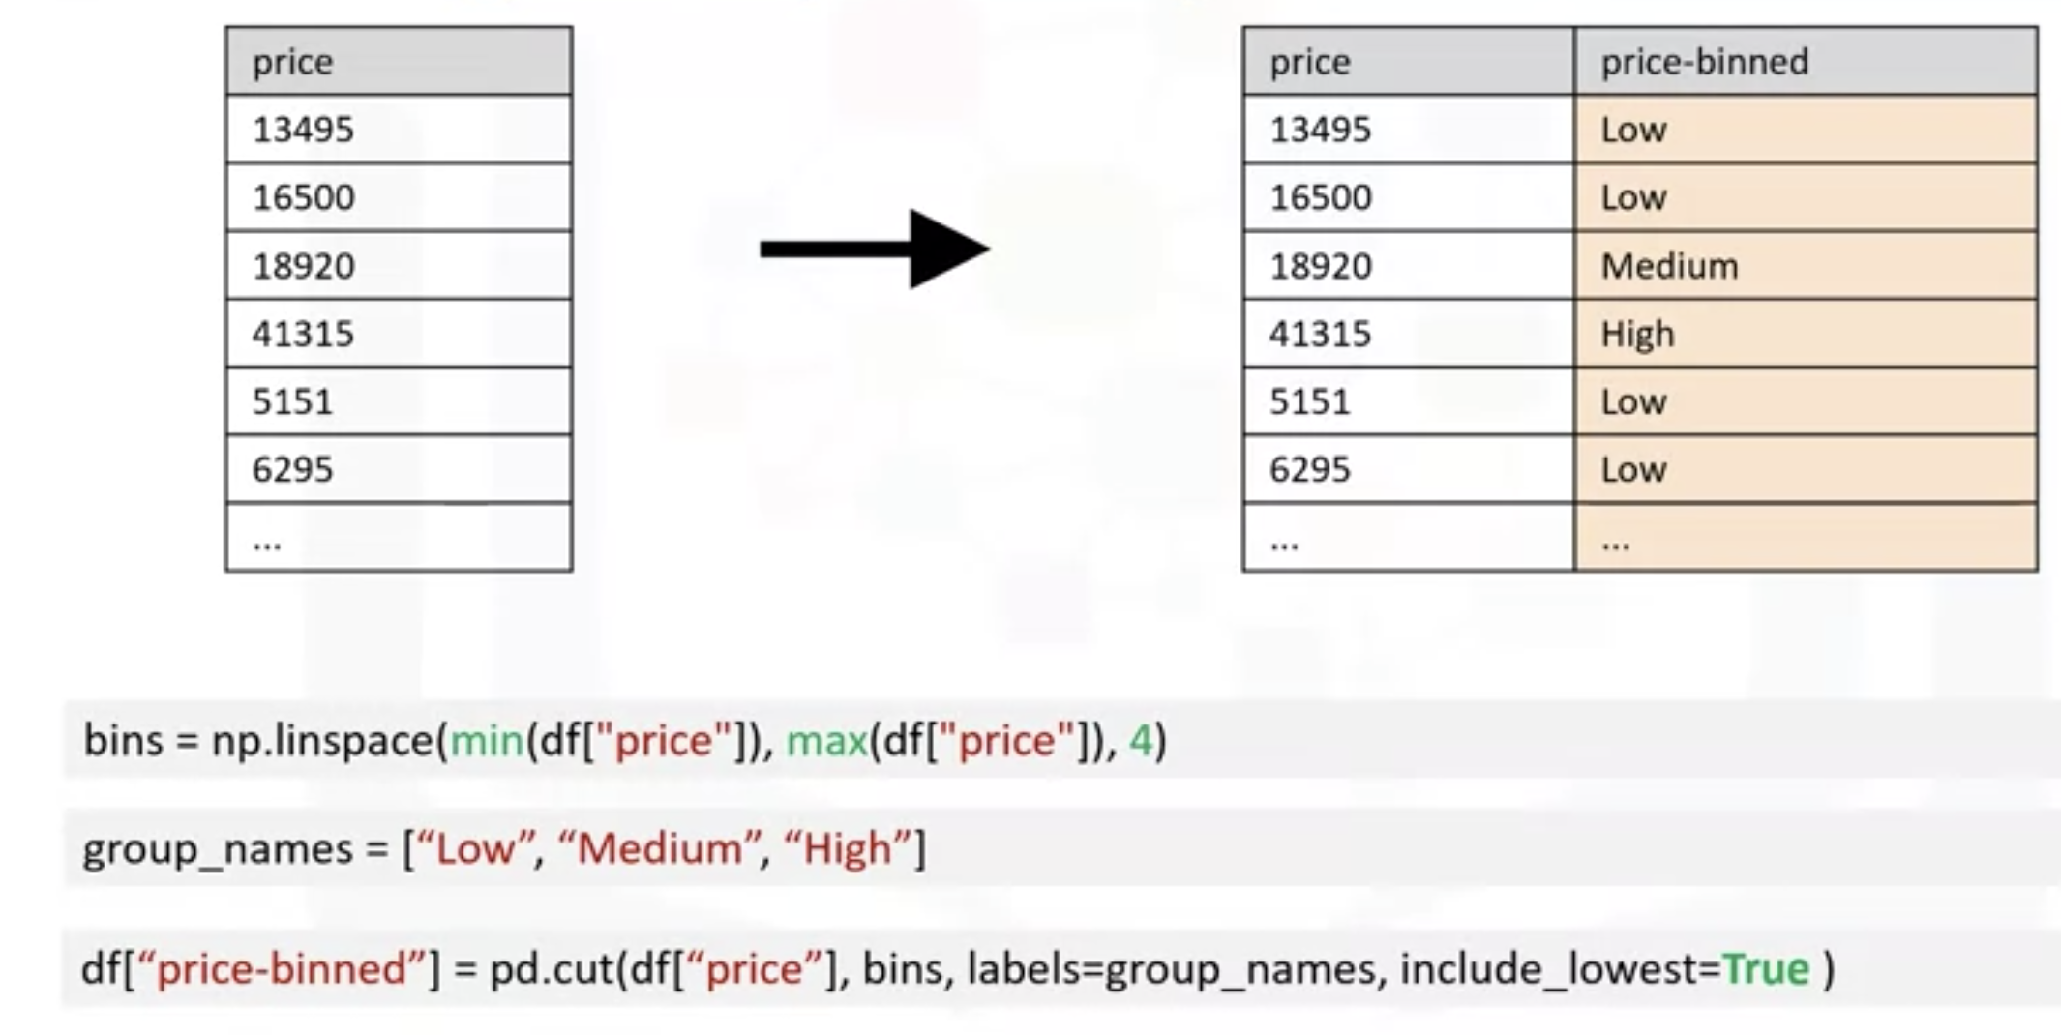
Binning in Python
What is Binning data?
  Grouping of values into “bins”→ you can bin “age” into [0 to 5], [6 to 10], [11 to 15]
  Group a set of numerical values into a smaller number of bins to have a better understanding of the data distribution→ we categorize the price into three bins: low price, medium price, and high prices.
Data Wrangling

Slide 9
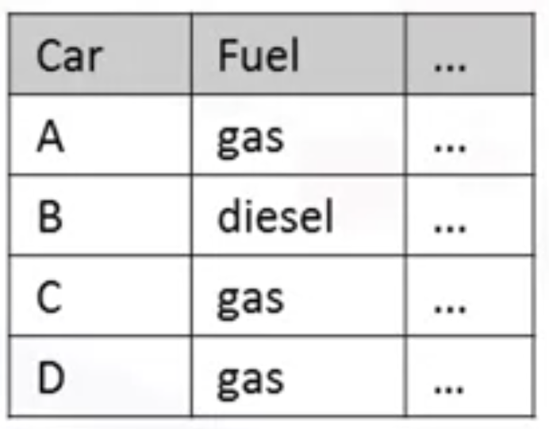
Turning categorical variables into quantitative variables
Problem
  Most statistical models can not take in the objects/ strings as input
  How to turn categorical variables into quantitative variables( numeric, string)
  The fuel type feature as a categorical variable has two values, gas or diesel, which are in string format
Data Wrangling

Slide 10
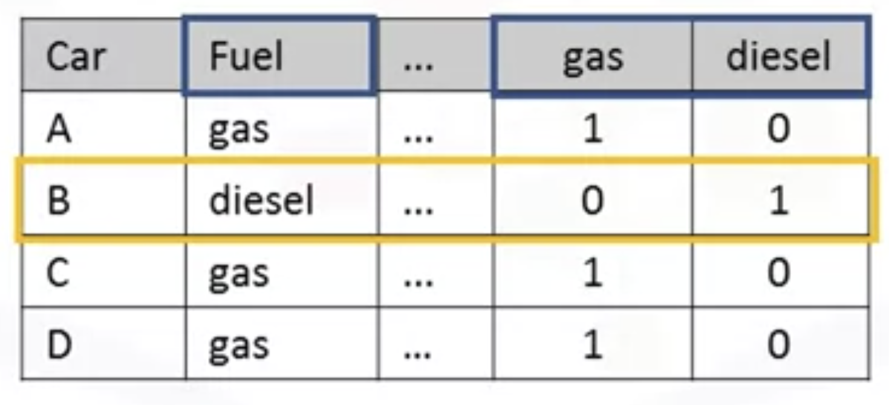
Turning categorical variables into quantitative variables
Categorical → Numeric: “one-hot encoding” technique
  Add dummy variables for each unique category
  Assign 0 or 1 in each category
Data Wrangling

Slide 11
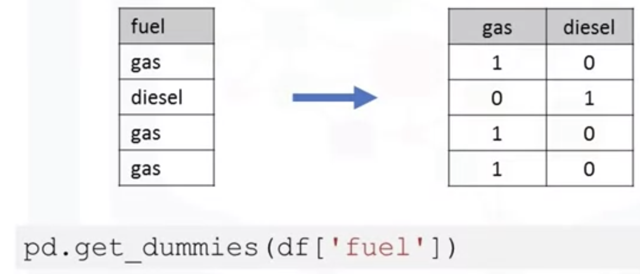
Turning categorical variables into quantitative variables
Pandas.get_dummies(): convert categorical variables to dummy variables( o or 1)
Data Wrangling

Slide 12
Summary
Describe data normalization
Demonstrate the use of binning
Demonstrate the use of categotical variables
Data Wrangling

Slide 13
Q & A
Data Wrangling

